Slide 1

Add Prudential Image as background
Prudential People Analytics to Maximize Business Value
Feb 2019

Slide 2
Agenda
Our understanding of your needs
Proposed Process
Pricing
About Pulsifi
Appendix
1
2
3
4
5

Slide 3
Agenda
Our understanding of your needs
Proposed Process
Pricing
About Pulsifi
Appendix
1
2
3
4
5

Slide 4
Our understanding of your needs
JAMIE
Replace image
Prudential Assurance Company Singapore (PACS) aspires to be the market leader in productivity, and would like to maximize value in sales channels.
To achieve these aspirations, PACS would like to leverage data analytics to inform resource allocation for:
Recruiting: recruit Financial Consultants (FC) and Agency Leaders (AL) with traits that best predict performance and retention (especially within 24 months)
Performance management: offer the right incentives to FC and AL based on what matters to them
Attrition: intervene when there are red flags of FC at risk of leaving

Slide 5
Aspired outcomes: PACS armed with insights that drive more effective resource allocation
JAMIE
Recruiting
Performance management
Retention
Persona 1
Trait 1
Trait 2
Persona 2
Trait 1
Trait 2
Incentive type 1: most effective for Persona A, B
Incentive type 2: most effective for Persona C
Red flag 1
Red flag 2
Red flag 3
Red flag 4
Inform recruiting channels, candidate sources etc.
Send targeted incentives to drive candidate performance
Identify FC / AL at risk of attrition for intervention

Slide 6
Agenda
Our understanding of your needs
Proposed Process
Pricing
About Pulsifi
Appendix
1
2
3
4
5

Slide 7
Overall approach
JAMIE
Part A
Part B
Roll-out
Align on hypothesis
Collect data
Process & analyze data
Establish personas
Propose Implications
Build in platform
Develop hypotheses on personas to establish sample size needed
Qualitative insights collection
Process unstructured data
Interpret results of quant analysis and triangulate against qual insights
Develop recommendations based on personas
Incorporate findings into Pulsifi platform to support ongoing business use
Quantitative data collection
Run models / algorithms (help pls!!)
Propose visualization & ongoing ML platform

Slide 8
Overall approach
Part A
Part B
Roll-out
Align on hypothesis
Collect data
Process & analyze data
Establish personas
Propose Implications
Build in platform
Develop hypotheses on personas to establish sample size needed
Qualitative insights collection
Process unstructured data
Interpret results of quant analysis and triangulate against qual insights
Develop recommendations based on personas
Incorporate findings into Pulsifi platform to support ongoing business use
Quantitative data collection
Run models / algorithms (help pls!!)
Propose visualization & ongoing ML platform

Slide 9
Align on hypotheses (1/2)
YVONNE?
Why do we need to align on hypotheses?
The sample size of respondents required depends on number of clusters we will be splitting data for analysis
Each cluster requires sample size of 30 to be statistically significant
Preliminary hypotheses
FC & AL separate categories
Good-strong performers vs weak performers (the rest)
Stayers vs leavers (within 24 months?)
At least 2 different types of personas of strong performers

Slide 10
Align on hypotheses (2/2)
YVONNE?
 | Performance (Strong – good) | Performance (Poor)
Attrition (Stay beyond 24 months)
Attrition (Leave within 24 months)
Persona 1 (30)
Persona 2 (30)
Persona 1 (30)
Persona 2 (30)
Persona 1 (30)
Persona 2 (30)
Persona 1 (30)
Persona 2 (30)
Based on above hypotheses, we require: 30 x 8 = 240 respondents for FC & AL separately
Each group should encompass a good mix of factors that are hypothesized to be potential predictors e.g. length of working before joining, education background…
Persona hypotheses will also inform the scope of qualitative research

Slide 11
Overall approach
Part A
Part B
Roll-out
Align on hypothesis
Collect data
Process & analyze data
Establish personas
Propose Implications
Build in platform
Develop hypotheses on personas to establish sample size needed
Qualitative insights collection
Process unstructured data
Interpret results of quant analysis and triangulate against qual insights
Develop recommendations based on personas
Incorporate findings into Pulsifi platform to support ongoing business use
Quantitative data collection
Run models / algorithms (help pls!!)
Propose visualization & ongoing ML platform

Slide 12
Collect data (1/3): Qualitative data
YVONNE?
In-depth interview / ethnographic research of each persona
Identify insights and trait that could inform quant analysis
(to come up with something + figure out who we want to outsource this to, so we can co-develop this section?)

Slide 13
Collect data (2/3): Quantitative data
Proposed data points to be collected
Sales
Customers
Screening assessments (our PICA stuff?)
Social media
Joining Age
Tenure
Education, (school, major, grades?)
Occupation,
marital status,
re-joining/newly joined,
currently being a Prudential customer
clean records – BSC, persistency ratio
factors from external or publicly available data
influence of network circle (social media?)
Feedback of peers / network
Work experience
Training data: trainings attended?
Attrition
Awards given
AL / manager
…
CALEB
Let’s create a long list then categorize into broader buckets?
Demographic
Education
Soft traits
Performance
Company
…

Slide 14
Collect data (2/3): Quantitative data
Data point | Approach to collect
CALEB
After we land on the list of data required, we should have a table to flesh out how we propose collecting the data

Slide 15
Overall approach
Part A
Part B
Roll-out
Align on hypothesis
Collect data
Process & analyze data
Establish personas
Propose Implications
Build in platform
Develop hypotheses on personas to establish sample size needed
Qualitative insights collection
Process unstructured data
Interpret results of quant analysis and triangulate against qual insights
Develop recommendations based on personas
Incorporate findings into Pulsifi platform to support ongoing business use
Quantitative data collection
Run models / algorithms (help pls!!)
Propose visualization & ongoing ML platform

Slide 16
Process & analyze data
CALEB
Ok this one I really don’t have the right words the phrase this section pls help lol

Slide 17
Overall approach
Part A
Part B
Roll-out
Align on hypothesis
Collect data
Process & analyze data
Establish personas
Propose Implications
Build in platform
Develop hypotheses on personas to establish sample size needed
Qualitative insights collection
Process unstructured data
Interpret results of quant analysis and triangulate against qual insights
Develop recommendations based on personas
Incorporate findings into Pulsifi platform to support ongoing business use
Quantitative data collection
Run models / algorithms (help pls!!)
Propose visualization & ongoing ML platform

Slide 18
Establish personas
JAMIE + YVONNE
Think we might want to share illustrative output here?

Slide 19
Overall approach
Part A
Part B
Roll-out
Align on hypothesis
Collect data
Process & analyze data
Establish personas
Propose Implications
Build in platform
Develop hypotheses on personas to establish sample size needed
Qualitative insights collection
Process unstructured data
Interpret results of quant analysis and triangulate against qual insights
Develop recommendations based on personas
Incorporate findings into Pulsifi platform to support ongoing business use
Quantitative data collection
Run models / algorithms (help pls!!)
Propose visualization & ongoing ML platform

Slide 20
Propose implications (1/2) Findings will be structured to tie into actionable implications
JAMIE (discuss with Yvonne)
Think we might want to share illustrative output here

Slide 21
Propose implications (2/2) Findings will be shared across different visualization tools
CALEB
Think we might want to share illustrative output here

Slide 22
Overall approach
Part A
Part B
Roll-out
Align on hypothesis
Collect data
Process & analyze data
Establish personas
Propose Implications
Build in platform
Develop hypotheses on personas to establish sample size needed
Qualitative insights collection
Process unstructured data
Interpret results of quant analysis and triangulate against qual insights
Develop recommendations based on personas
Incorporate findings into Pulsifi platform to support ongoing business use
Quantitative data collection
Run models / algorithms (help pls!!)
Propose visualization & ongoing ML platform

Slide 23
Overall implementation timeline
Yvonne + Caleb
take a look at timeline and let me know if any feedback?
Part A
Part B
Roll-out
Align on hypothesis
Collect data
Process & analyze data
Establish personas
Propose Implications
Build in platform
Develop hypotheses on personas to establish sample size needed
Qualitative insights collection
Process unstructured data
Interpret results of quant analysis and triangulate against qual insights
Develop recommendations based on personas
Incorporate findings into Pulsifi platform to support ongoing business use
Quantitative data collection
Run models / algorithms (help pls!!)
Propose visualization & ongoing ML platform
1 week
4 weeks
3 weeks
2 weeks
2 weeks
Note: attrition analysis may not have sufficient data for complete analysis; will run first cut analysis excluding data that needs to be collected (that PACS doesn’t already have), propose a re-run of analysis after say, 3-6 months, when more data on people who attrite is collected

Slide 24
Build in platform
JAMIE
Insights from the analysis can be incorporated into Pulsifi’s platform to become more actionable e.g.
Recruiting: Key persona traits can be integrated into the platform, and fit scores assigned to candidates to determine fit
Performance management: Base on each FC / AL, identify areas of development for employee (against ideal personas), identify incentives most suitable for FC / AL etc.
Retention: feed ongoing data to platform to identify FC / AL
…

Slide 25
Agenda
Our understanding of your needs
Proposed Process
Pricing
About Pulsifi
Appendix
1
2
3
4
5

Slide 26
Placeholder for pricing
JAMIE TO DISCUSS WITH JAY
Components of pricing:
Our original model: no. of “clusters”/units x price per unit (8 x 3,500 = 28,000)
Cost of creating an employee profile x no, required (30 x 8 x 50 = 12,000)
Data science analytics insights: no. of use cases x per unit cost (3 x 5,000 = 15)
Qualitative research (8 x 1,000 = 8,000)
Visualization tools for presentation?
Any other costs?

Slide 27
Agenda
Our understanding of your needs
Proposed Process
Pricing
About Pulsifi
Appendix
1
2
3
4
5

Slide 28
Our platform recommends people based on the ideal mix of
hard skills and soft traits for each role
People Analytics software platform
Our approach combines
organizational psychology, A.I., predictive models and machine learning

Slide 29





Our platform recommends people
Sales Manager
Predicted fit scores encompass performance, engagement, and retention – which impact people decisions such as:
Candidates
Fit score
Candidate 1
Candidates who applied for the role
Talent acquisition
High potential identification
Candidate 2
Promotions and rotations
Succession planning
Existing employees
Candidate 3
Teaming
Learning and development
Passive candidates from databases
Candidate 4

Slide 30







Based on hard skills and soft traits
Work attitudes like grit, leadership, teamwork, motivation to learn are highly sought after by employers, and contribute to work behaviors like performance
Fit between employees' and organization's values predicts how soon an employee might leave the organization
Work Attitudes and Behaviors
Work Culture
Competencies
We unify people data across multiple sources
The alignment between employees' vocational interests and job type is key to job performance
Work Interest
Experience
Click here to view
an example of a holistic profile
CV
Psychometric
assessments
Social media
Personality
Cognitive abilities
Personality contributes up to 49% to job performance
Cognitive ability predicts job performance, especially when job complexity is high
Chatbots
Video interview
Game-based
Assessments
Employee
data
…and others
Pulsfi’s framework is backed by published organizational psychology research

Slide 31




According to the ideal mix for each role
Ongoing feedback refines algorithms
Fit algorithm based on organizational psychology to optimize performance for each job
Benchmark existing employees to identify traits which predict outcomes like performance
Align mix of traits with HR and hiring managers
Machine learning from actual selection and hiring choices, and post-hire performance

Slide 32


Case study: We successfully help a multinational improve their recruitment
Context
Nestlé’s top-rated Management Trainee program attracts thousands of applicants annually
Reviewing applications was manual, and it was challenging to consistently identify candidates with traits that were important to hiring managers
What we do
Predict and assess mix of hard and soft traits of candidates:
Work attitudes and behavior
Personality
Work interest
Work culture
Cognitive abilities
Education
Work internship / experience
via CV, psychometric assessments
and video interviews
Outcome and benefits
Selected top 200 candidates from 3,000+ applicants
100%
70%
quality improvement in candidate selection
reduction in manhours
Enhanced brand
3 weeks → 3 days
typical time to notify candidates in between stages
image as a modern employer
Nestlé Malaysia and Singapore use Pulsifi to select young talent such as Management Trainees

Slide 33

























Our team brings you the right set of expertise
Human resources, psychology and consulting
Artificial intelligence and data science
Head, Staffing
Services
Area Director
PhD, Industrial &
Organizational Psychology
Project Leader
PhD, Mathematical
Modeling
MS, Computer Science & Machine Learning
BS, Math
Software engineering and user experience
Built other successful companies
Web development mentor
Investors and advisors
Tech partners
Ex Regional Operating
Officer
Ex Senior Partner
Managing Director
Prof, A.I.
Ex HR Business Partner

Slide 34






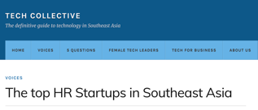
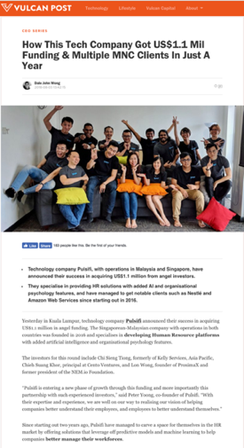
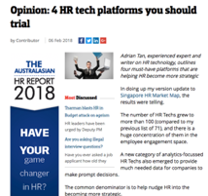
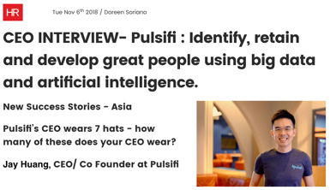
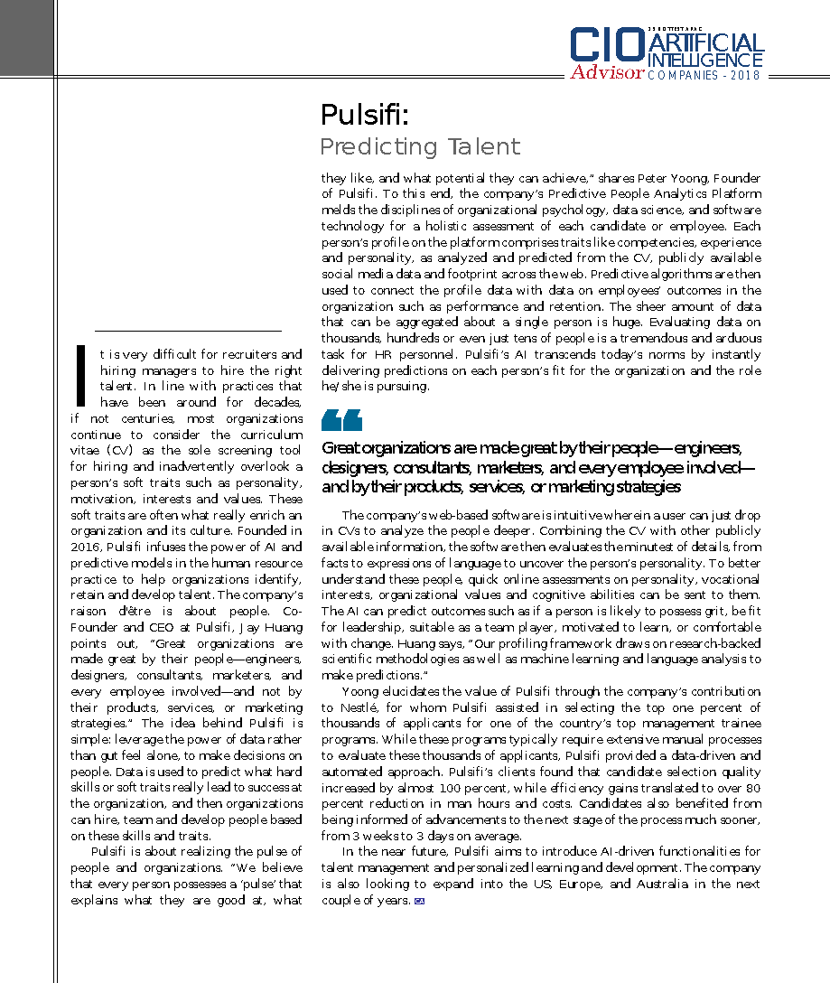
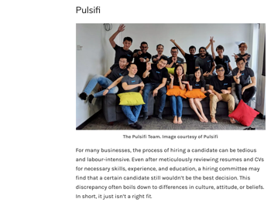

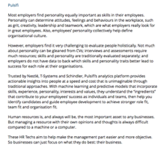













Recent features of Pulsifi in the media
25 HOTTEST APAC
How This Tech Company Got US$1.1 Mil Funding & Multiple MNC Clients In Just A Year
CEO Interview
Pulsifi:
Predicting Talent
4 HR tech platforms
you should trial
Top HR Startups in Southeast Asia

Slide 35
Project team
Tbc who to put in team?
Should See be in there somewhere, and if so, who to replace in this slide?
Jamie Ko – Director, Business Development
Previously Project Leader at The Boston Consulting Group
Led organization redesign and developed HR operating models for global organizations
BBM, Business Management and BAcc, Accountancy, Singapore Management University
Dr Yvonne Tan – Organizational & Research Psychologist
Associate Lecturer in Psychology at SIM Global Education
Previously independent HR and research consultant for clients such as Aon Hewitt and Cisco Systems
PhD, Industrial and Organizational Psychology, Singapore Management University
Chung Jaan Hao – Chief Operating Officer
Over 20 years of experience in digital
Previously Co-founder & CEO, MNC Wireless (KLSE-listed) and Head, Business Development, iflix
BSc, Finance, Bowling Green State University
Ashley Narayanan – Director, Client Engagement
Over 20 years of experience in HR and managing operations
Previously Head, Staffing Services at Manpower Group and Area Director, Kelly Services
BSc, Economics, University of London and Lean Six Sigma Black Belt
Caleb Foong – Data & Research Scientist
Previously Fusionex International
MSc, Computer Science and Machine Learning, Lancaster University
BSc, Math, National University of Singapore
Lydia Lim – Solution Architect
Development Lead and Principal Software Engineer, Monster Technologies
BSc, Information System Engineering, Campbell University

Slide 36
Our commitment to you
You have a super strong team to support you
We will partner your teams
Our success is defined by your success

Slide 37
Agenda
Our understanding of your needs
Proposed Process
Pricing
About Pulsifi
Appendix
1
2
3
4
5

Slide 38
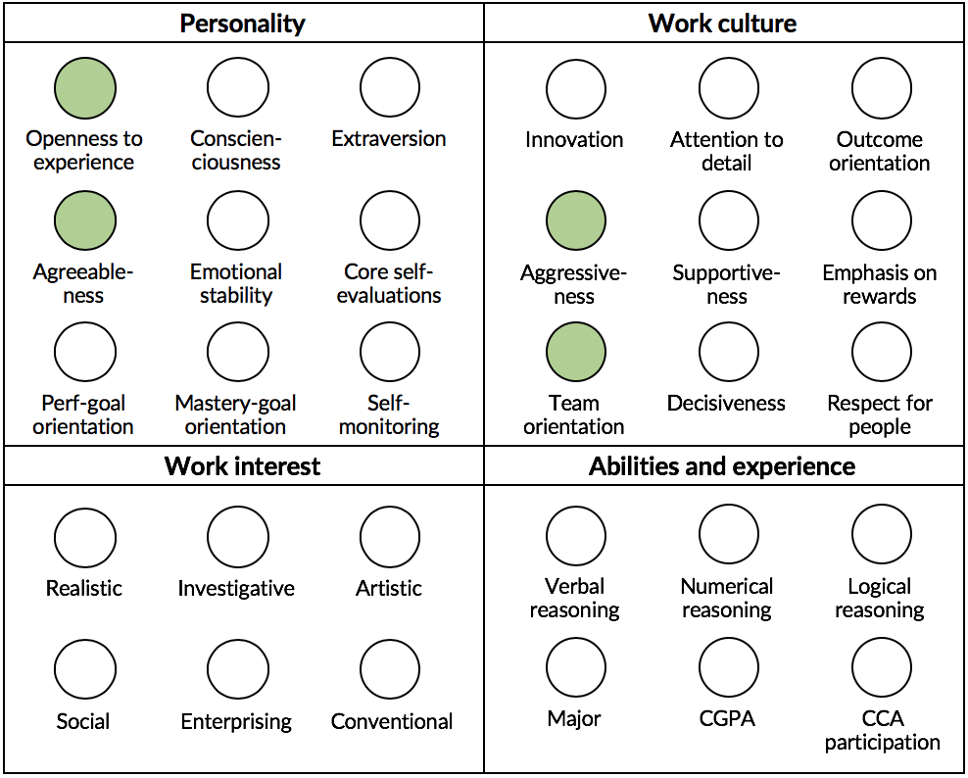
Example: Ideal model of traits for a role
Common traits identified for successful hires
Work attitudes / behaviors
Grit
Proactivity
Motivation to learn
Comfort with change
Creativity
Communication effectiveness
Leadership
Teamwork

Slide 39
Pulsifi uses multiple traits to predict outcomes that employers care most about
Our model predictions
exceed 80-90% accuracy
as validated by humans
Performance
Work attitudes and behaviors
Grit
Proactivity
Motivation to learn
Comfort with change
Creativity
Communication effectiveness
Multi-tasking
Leadership
Teamwork
Performance
Entrepreneurship
Job satisfaction
Emotional commitment
Job burnout
Predicted
Competencies
Experience
Abilities
Personality
Work interest
Work culture
Skills
Knowledge
Abilities
Roles
Companies
Industries
Education
Verbal reasoning
Numeric reasoning
Logical reasoning
Openness
Conscientiousness
Extraversion
Agreeableness
Emotional stability
Core self-evaluations
Goal orientations
Self-monitoring
Realistic
Investigative
Artistic
Social
Enterprising
Conventional
Adaptability
Collaboration
Customer Orientation
Decisiveness
Detail Orientation
Emphasis on Rewards
Integrity
Outcome Orientation
Analyzed

Slide 40
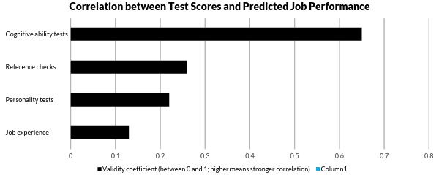
Pulsifi’s selection approach is most effective
Pulsifi’s approach
Multi-measure tests
Source: Harvard Business Review: Based on data by Frank Schmidt in a 6 Nov 2013 address to Personnel Testing Council Metropolitan Washington as an update to Schmidt & Hunter, 1998x

Slide 41
Personality
Scientific
Basis
Personality has been found by decades of research to be a predictor of a person’s job traits and outcomes, i.e. work attitudes and behaviors
(Erdheim, Wang & Zickar, 2006; Furnham & Zacherl, 1986; Judge & Bono, 2001; Salgado, 1997; Smith, Organ, & Near, 1983; Tett, Jackson, and Rothstein, 1991; Tokar & Subich, 1997; Zaccaro, Foti & Kenny, 2001)
These job traits and outcomes include:
Grit (Duckworth & Quinn, 2009)
Proactivity (Major et al., 2006)
Motivation to learn (Major, Turner, & Fletcher, 2006)
Comfort with change (Oreg, 2003)
Creativity (Woodman, Sawyer, & Griffin, 1993)
Communication effectiveness (Snyder, 1974)
Multi-tasking (Conte & Jacobs, 2003; Schell & Conte, 2008)
Scientific
Basis
Leadership (Stogfill, 1974)
Teamwork (Larson & LaFasto, 1989)
Performance (Harrison et al., 2006)
Entrepreneurship (Zhao & Seibert, 2006)
Job satisfaction and commitment (Harrison, Newman, & Roth, 2006)
Job burnout (Best, Stapleton, & Downey, 2005)

Slide 42
Personality
Scientific
Basis
Pulsifi’s Personality Model includes:
Five factors consisting of Openness to Experience, Conscientiousness, Extraversion, Agreeableness and Emotional Stability
Dominant model in the study of human psychology, including organizational psychology
Validated by tough critical tests since the 1960s (e.g. Tupes & Christal, 1961)
Versatile because other models of personality can be integrated under the Five Factor Model (John, Naumann, & Soto, 2008)
Additional traits:
Core Self-evaluations: Evaluations that people make about themselves and their functioning in their environment (Judge, Locke, & Durham, 1997; Judge, Van Vianen, & De Pater, 2004)
Mastery and Performance Goal Orientations: Focus on developing competence vs. establishing superiority over others (Janssen & Van Yperen, 2004)
Self-monitoring: Self-observation and self-control to ensure that one behaves appropriately in a social situation (Snyder, 1974; Zaccaro, Foti, & Kenny, 2001)

Slide 43
Personality
Scientific
Basis
Each facet of the Five Factor Model is further broken down into 6 sub-facets, thus measuring personality comprehensively:
Openness to experience
Conscientiousness
Extraversion
Agreeableness
Emotional stability
Imagination
Artistic interests
Emotionality
Adventurousness
Intellect
Liberalism
Self-efficacy
Orderliness
Dutifulness
Achievement-striving
Self-discipline
Cautiousness
Friendliness
Gregariousness
Assertiveness
Activity level
Excitement-seeking
Cheerfulness
Trust
Morality
Altruism
Cooperation
Modesty
Sympathy
Anxiety
Anger
Depression
Self-consciousness
Immoderation
Vulnerability

Slide 44
Work Interest
Scientific
Basis
Employee vocational interest has been found to be related to job outcomes, such as job satisfaction, performance, and burnout
(Jagger, Neukrug, & McAuliffe, 1992; Meir, Melamed, & Dinur, 1995; Meir & Navon, 1992; Meir & Tzadok, 2000; Oleski & Subich, 1996)
Pulsifi’s Vocational Interest Model includes:
Holland’s RIASEC model consisting of Realistic, Investigative, Artistic, Social, Enterprising, Conventional vocational interest typology
Linked to personality types and hence can be cross-referenced (Barrick, Mount, & Gupta, 2003; Gottfredson, Jones, & Holland, 1993; Tokar & Swanson, 1995)
Used by the Occupational Information Network (O*NET) developed under the US Department of Labor, which is a repository of thousands of occupations and their definitions such as knowledge, skills, and abilities
Scientific
Basis

Slide 45
Work Culture
Scientific
Basis
Values and culture fit between employee and organization has been found to be related to job outcomes such as job satisfaction, organizational commitment and actual turnover
(O’Reilly, Chatman, & Caldwell, 1991; Vandenberghe, 1999)
Pulsifi’s Culture Model includes 8 values:
Adaptability, Collaboration, Customer Orientation, Decisiveness, Detail Orientation, Emphasis on Rewards, Integrity, Outcome Orientation
Developed from both employees’ values and organizations' values and widely cited by researchers
Two perspectives to determine the level of culture fit
Top leaders determine the organizational culture
Respondents identify what they value in an organization
Scientific
Basis

Slide 46
Cognitive Abilities
Scientific
Basis
Various cognitive ability tests can predict practical work outcomes (job knowledge acquisition, training performance, and job performance) across many jobs (Levine, Spector, Menon, Narayanan, Cannon-Bowers, 1996)
Pulsifi’s Cognitive Ability Tests include:
Verbal Reasoning: measures the ability to use English in the workplace: to understand verbal information, think logically about written information, and accurately draw logical conclusions
Logical Reasoning: measures the ability to interpret and detect trends and patterns
Numeric Reasoning: measures the ability to work with numbers, math functions and the interpretation of data
Other cognitive ability tests can also be included based on client’s needs

Slide 47
Is my employee data private?
Yes!
Your employee data, including data obtained with consent from employee social logins, is not shared with or accessible by other companies.
Your employee data is on its own database that is accessible only by authorized users from your company.
There is no reason for Pulsifi to share your employee data. We are providing a software platform, not selling data or selling candidates.
Many companies put their employee data on cloud-based HRMS like Workday, and even highly confidential customer data on cloud-based CRM like Salesforce.

Slide 48
Where will our data be stored and what are the security measures in place?
Your data is hosted on Amazon Web Services (AWS), which offers:
Millions of dollars invested in cutting-edge data security
Network firewalls to control data access
Encryption of data in transit and at rest
Distributed Denial of Service (DDoS) mitigation
Global infrastructure of 42 availability zones within 16 geographic regions
Control over the region that the data is physically stored to meet compliance requirements
Source: Amazon Web Services Security (https://aws.amazon.com/security/)

Slide 49
Let’s talk!
Jamie Ko
Director, Business Development jamie@pulsifi.me
Jay Huang
Co-founder & CEO jay@pulsifi.me

